Slide 1
Sorting Algorithms Lecture 9

Slide 2
Sorting by Exchange: Shell Sort
Sorting methods based on comparison:
Comparisons and hence movements of data take place between adjacent entries only
This leads to a number of redundant comparisons and data movements
A mechanism should be followed with which the comparisons can take in long leaps instead of short
Donald L. Shell (1959)
Use increments:

Slide 3
Shell Sort
Shell sort, also known as the diminishing increment sort, is one of the oldest sorting algorithms
It improves on insertion sort
Starts by comparing elements far apart, then elements less far apart, and finally comparing adjacent elements (effectively an insertion sort). By this stage the elements are sufficiently sorted that the running time of the final stage is much closer to O(N) than O(N²)
Notes:
Shellsort is a generalization of insertion sort that allows the exchange of items that are far apart. The idea is to arrange the list of elements so that, starting anywhere, considering every hth element gives a sorted list. Such a list is said to be h-sorted. Equivalently, it can be thought of as h interleaved lists, each individually sorted. Beginning with large values of h, this rearrangement allows elements to move long distances in the original list, reducing large amounts of disorder quickly, and leaving less work for smaller h-sort steps to do. If the file is then k-sorted for some smaller integer k, then the file remains h-sorted. Following this idea for a decreasing sequence of h values ending in 1 is guaranteed to leave a sorted list in the end.

Slide 4
Shell Sort

Slide 5
Shell Sort (Steps)
Let A be a linear array of n numbers A [1], A [2], A [3], ...... A [n].
Step 1:
The array is divided into k sub-arrays consisting of every kth element. Say k= 5, then five sub-array, each containing one fifth of the elements of the original array
Sub array 1 → A[0] A[5] A[10]
Sub array 2 → A[1] A[6] A[11]
Sub array 3 → A[2] A[7] A[12]
Sub array 4 → A[3] A[8] A[13]
Sub array 5 → A[4] A[9] A[14]
Note : The ith element of the jth sub array is located as A [(i–1) × k+j–1]

Slide 6
Shell Sort (Steps)
Step 2:
After the first k sub array are sorted (usually by insertion sort) , a new smaller value of k is chosen and the array is again partitioned into a new set of sub arrays

Slide 7
Shell Sort (Steps)
Step 3:
And the process is repeated with an even smaller value of k, so that A [1], A [2], A [3], ....... A [n] is sorted

Slide 8
Shell Sort: Illustration

Slide 9
Shell Sort: Illustration

Slide 10
Shell Sort: Illustration

Slide 11
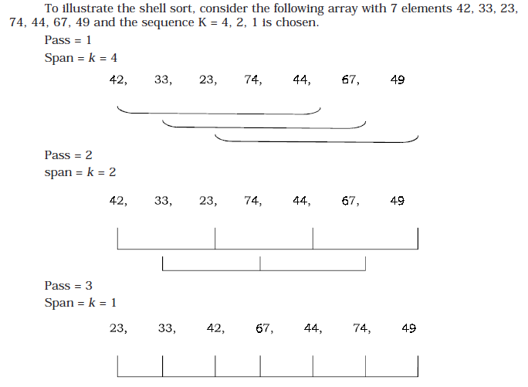
Shell Sort: Illustration

Slide 12
ALGORITHM
Let A be a linear array of n elements, A [1], A [2], A [3], ...... A[n] and Incr be an array of sequence of span to be incremented in each pass. X is the number of elements in the array Incr. Span is to store the span of the array from the array Incr.
1. Input n numbers of an array A
2. Initialise i = 0 and repeat through step 6 if (i < x)
3. Span = Incr[i]
4. Initialise j = span and repeat through step 6 if ( j < n)
(a) Temp = A [ j ]
5. Initialise k = j-span and repeat through step 5 if (k > = 0) and (temp < A [k ])
(a) A [k + span] = A [k]
6. A [k + span] = temp
7. Exit

Slide 13
SHELL SORT (Example)
 | Pass # 1 i= num / 2 ( i= 7/2 = 3)
 | index
 | 0 | 1 | 2 | 3 | 4 | 5 | 6
1 | 42 | 33 | 23 | 74 | 44 | 67 | 49 | j = i | J=3
 | k |  |  | K+i |  |  |  | K=j-i | K=3-3=0
 |  |  |  |  |  |  |  |  | K+i = 3
2 | 42 | 33 | 23 | 74 | 44 | 67 | 49 |  | J=4
 |  | k |  |  | K+I |  |  |  | K=4-3=1
3 | 42 | 33 | 23 | 74 | 44 | 67 | 49 |  | J=5
 |  |  | k |  |  | K+i |  |  | K=5-3=2
3 | 42 | 33 | 23 | 74 | 44 | 67 | 49 |  | J=6
 |  |  |  | k | swap |  | K+i |  | K=6-3=3
 | 42 | 33 | 23 | 49 | 44 | 67 | 74
for(i=num/2; i>0; i=i/2) { for(j=i; j<num; j++) { for(k=j-i; k>=0; k=k-i) { if(arr[k+i]>=arr[k]) break; else { tmp=arr[k]; arr[k]=arr[k+i]; arr[k+i]=tmp; } } }
Notes:
just like a bubble sort does. The only difference between the two sorting algorithms is the manner in which they compare the elements.
In some situations the exchange sort is slightly more efficient than its counter part the bubble sort. The bubble sort needs a final pass to determine that it is finished, thus is slightly less efficient than the exchange sort, because the exchange sort doesn’t need a final pass.

Slide 14
SHELL SORT (Example)
 | Pass # 2 i= i / 2 ( i= 3 / 2 = 1)
 | index
 | 0 | 1 | 2 | 3 | 4 | 5 | 6
1 | 42 | 33 | 23 | 49 | 44 | 67 | 74 | j = i | J=1
 | k | K+i |  |  |  |  |  | K=j-i | K=1-1=0
 |  |  |  |  |  |  |  |  | K+i = 1
2 | 33 | 42 | 23 | 49 | 44 | 67 | 74 |  | J=2
 |  | k | K+i |  |  |  |  |  | K=2-1= 1
3 | 33 | 23 | 42 | 49 | 44 | 67 | 74
 | k | K+i | K=k-i
3 | 23 | 33 | 42 | 49 | 44 | 67 | 74 |  | J=3
 |  |  | k | K+i |  |  |  |  | K=3-1=2
4 | 23 | 33 | 42 | 49 | 44 | 67 | 74 |  | J=4
 |  |  |  | K | K+i |  |  |  | K=4-1=3
for(i=num/2; i>0; i=i/2) { for(j=i; j<num; j++) { for(k=j-i; k>=0; k=k-i) { if(arr[k+i]>=arr[k]) break; else { tmp=arr[k]; arr[k]=arr[k+i]; arr[k+i]=tmp; } } }
Notes:
just like a bubble sort does. The only difference between the two sorting algorithms is the manner in which they compare the elements.
In some situations the exchange sort is slightly more efficient than its counter part the bubble sort. The bubble sort needs a final pass to determine that it is finished, thus is slightly less efficient than the exchange sort, because the exchange sort doesn’t need a final pass.

Slide 15
SHELL SORT (Example)
 | Pass # 2 i= i / 2 ( i= 3 / 2 = 1)
 | index
 | 0 | 1 | 2 | 3 | 4 | 5 | 6
4 | 23 | 33 | 42 | 49 | 44 | 67 | 74 |  | J=4
 |  |  |  | K | K+i |  |  |  | K=4-1=3
5 | 23 | 33 | 42 | 44 | 49 | 67 | 74 |  | J=5
 |  |  |  |  | K | K+i |  |  | K=5-1=4
5 | 23 | 33 | 42 | 44 | 49 | 67 | 74 |  | J=6
 |  |  |  |  |  | K | K+i |  | K=6-1=5
SORTED
for(i=num/2; i>0; i=i/2) { for(j=i; j<num; j++) { for(k=j-i; k>=0; k=k-i) { if(arr[k+i]>=arr[k]) break; else { tmp=arr[k]; arr[k]=arr[k+i]; arr[k+i]=tmp; } } }
Notes:
just like a bubble sort does. The only difference between the two sorting algorithms is the manner in which they compare the elements.
In some situations the exchange sort is slightly more efficient than its counter part the bubble sort. The bubble sort needs a final pass to determine that it is finished, thus is slightly less efficient than the exchange sort, because the exchange sort doesn’t need a final pass.

Slide 16
SHELL SORT PROGRAM
#include<stdio.h> #include<conio.h> int main() { int arr[30]; int i,j,k,tmp,num; printf("Enter total no. of elements : "); scanf("%d", &num); for(k=0; k<num; k++) { printf("\nEnter %d number : ",k+1); scanf("%d",&arr[k]); } for(i=num/2; i>0; i=i/2) { for(j=i; j<num; j++) { for(k=j-i; k>=0; k=k-i) { if(arr[k+i]>=arr[k]) break; else { tmp=arr[k]; arr[k]=arr[k+i]; arr[k+i]=tmp; } } }
Notes:
just like a bubble sort does. The only difference between the two sorting algorithms is the manner in which they compare the elements.
In some situations the exchange sort is slightly more efficient than its counter part the bubble sort. The bubble sort needs a final pass to determine that it is finished, thus is slightly less efficient than the exchange sort, because the exchange sort doesn’t need a final pass.

Slide 17
SHELL SORT PROGRAM
printf("For vlue of increment %d = \n\n", i); for(j=0; j<num; j++) { printf("%d\t",arr[j]); } printf("\n\n"); } printf("\t**** Shell Sorting ****\n"); for(k=0; k<num; k++) printf("%d\t",arr[k]); getch(); return 0; }
Notes:
just like a bubble sort does. The only difference between the two sorting algorithms is the manner in which they compare the elements.
In some situations the exchange sort is slightly more efficient than its counter part the bubble sort. The bubble sort needs a final pass to determine that it is finished, thus is slightly less efficient than the exchange sort, because the exchange sort doesn’t need a final pass.

Slide 18
The Complexity
If an appropriate sequence of increments is classified, then the order of the shell sort is:
f (n) = O(n* log²n)

Slide 19
Shell Sort
In the Sample, arbitrarily chose sub array sizes of 1, 3 and 5
In reality that increment isn’t ideal, but then it isn’t clear what increment is
From empirical studies, a suggested increment follows this pattern;
h₁ = 1
h_{i+1} = 3h_{i}+1
until h_{t+2} ≥n

Slide 20
Issues in Shell Sort
Algorithm to be used to sort subsequences in shell sort
Straight insertion sort
Shell sort is better than the insertion sort
Lower number of passes than n number of passes in insertion sort
Deciding the values of increments
Several choices have been made

Slide 21
RADIX SORT
Radix sort or bucket sort is a method that can be used to sort a list of numbers by its base
If we want to sort list of English words, where radix or base is 26, then 26 buckets are used to sort the words

Slide 22
RADIX SORT

Slide 23
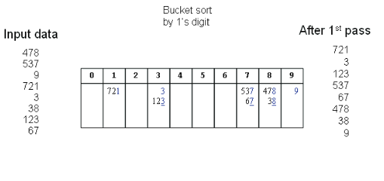
RADIX SORT EXAMPLE (1st Pass)

Slide 24
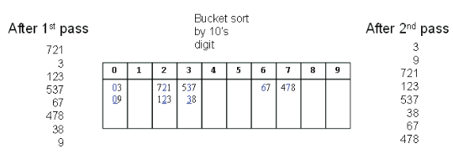
RADIX SORT EXAMPLE (2nd Pass)

Slide 25
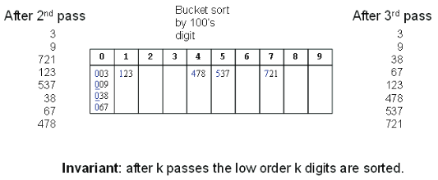
RADIX SORT EXAMPLE (3rd Pass)

Slide 26
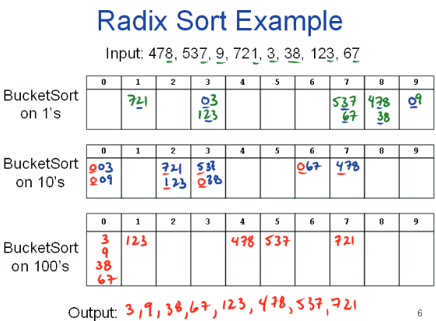
RADIX SORT EXAMPLE

Slide 27
ALGORITHM
Let A be a linear array of n elements A [1], A [2], A [3],...... A [n]. Digit is the total number of digits in the largest element in array A.
1. Input n number of elements in an array A.
2. Find the total number of Digits in the largest element in the array.
3. Initialize i = 1 and repeat the steps 4 and 5 until (i <= Digit).
4. Initialize the buckets j = 0 and repeat the steps (a) until ( j < n)
(a) Compare ith position of each element of the array with bucket number and
place it in the corresponding bucket.
5. Read the element(s) of the bucket from 0th bucket to 9th bucket and from first
position to higher one to generate new array A.
6. Display the sorted array A.
7. Exit.

Slide 28
RADIX SORT EXAMPLE
 | index
 | 0 | 1 | 2 | 3 | 4 | 5 | 6 | 7 | 8 | 9
 | 170 | 45 | 75 | 90 | 802 | 24 | 2 | 66
Notes:
just like a bubble sort does. The only difference between the two sorting algorithms is the manner in which they compare the elements.
In some situations the exchange sort is slightly more efficient than its counter part the bubble sort. The bubble sort needs a final pass to determine that it is finished, thus is slightly less efficient than the exchange sort, because the exchange sort doesn’t need a final pass.

Slide 29
count of occurrences in count[] | Change count[i] | Output array
count[ (arr[i]/exp)%10 ]++ | count[i] += count[i - 1] | output[count[ (arr[i]/exp)%10 ] - 1]
Count[0] 1 2 | 2 | 2 1 0
Count[1] 0 | 2 | 2
Count[2] 1 2 | 4 | 4 3 2
Count[3] 0 | 4 | 4
Count[4] 1 | 5 | 4
Count[5] 1 2 | 7 | 7 6 5
Count[6] 1 | 8 | 7
Count[7] 0 | 8 | 8
Count[8] 0 | 8 | 8
count[9] 0 | 8 | 8
Pass # 1
// Store count of occurrences in count[]
for (i = 0; i < n; i++)
count[ (arr[i]/exp)%10 ]++;
// Change count[i]
for (i = 1; i < 10; i++)
count[i] += count[i - 1];
// Build the output array
for (i = n - 1; i >= 0; i--)
{
output[count[ (arr[i]/exp)%10 ] - 1] = arr[i];
count[ (arr[i]/exp)%10 ]--;
}
Out put array
 | 0 | 1 | 2 | 3 | 4 | 5 | 6 | 7 | 8 | 9
 | 170 | 90 | 802 | 2 | 24 | 45 | 75 | 66
Notes:
just like a bubble sort does. The only difference between the two sorting algorithms is the manner in which they compare the elements.
In some situations the exchange sort is slightly more efficient than its counter part the bubble sort. The bubble sort needs a final pass to determine that it is finished, thus is slightly less efficient than the exchange sort, because the exchange sort doesn’t need a final pass.

Slide 30
count of occurrences in count[] | Change count[i] | Output array
count[ (arr[i]/exp)%10 ]++ | count[i] += count[i - 1] | output[count[ (arr[i]/exp)%10 ] - 1]
Count[0] 1 2 | 2 | 2 1 0
Count[1] 0 | 2 | 2
Count[2] 1 | 3 | 3 2
Count[3] 0 | 3 | 3
Count[4] 1 | 4 | 3
Count[5] 0 | 4 | 4
Count[6] 1 | 5 | 4
Count[7] 1 2 | 7 | 7 6 5
Count[8] 0 | 7 | 7
count[9] 1 | 8 | 8 7
Pass # 2
// Store count of occurrences in count[]
for (i = 0; i < n; i++)
count[ (arr[i]/exp)%10 ]++;
// Change count[i]
for (i = 1; i < 10; i++)
count[i] += count[i - 1];
// Build the output array
for (i = n - 1; i >= 0; i--)
{
output[count[ (arr[i]/exp)%10 ] - 1] = arr[i];
count[ (arr[i]/exp)%10 ]--;
}
Out put array
 | 0 | 1 | 2 | 3 | 4 | 5 | 6 | 7 | 8 | 9
 | 802 | 2 | 24 | 95 | 66 | 170 | 75 | 90
Notes:
just like a bubble sort does. The only difference between the two sorting algorithms is the manner in which they compare the elements.
In some situations the exchange sort is slightly more efficient than its counter part the bubble sort. The bubble sort needs a final pass to determine that it is finished, thus is slightly less efficient than the exchange sort, because the exchange sort doesn’t need a final pass.

Slide 31
count of occurrences in count[] | Change count[i] | Output array
count[ (arr[i]/exp)%10 ]++ | count[i] += count[i - 1] | output[count[ (arr[i]/exp)%10 ] - 1]
Count[0] 1 2 3 4 5 6 | 6 | 6 5 4 3 2 1 0
Count[1] 1 | 7 | 7 6
Count[2] 0 | 7 | 7
Count[3] 0 | 7 | 7
Count[4] 0 | 7 | 7
Count[5] 0 | 7 | 7
Count[6] 0 | 7 | 7
Count[7] 0 | 7 | 7
Count[8] 1 | 8 | 7
count[9] 0 | 8 | 8
Pass # 3
// Store count of occurrences in count[]
for (i = 0; i < n; i++)
count[ (arr[i]/exp)%10 ]++;
// Change count[i]
for (i = 1; i < 10; i++)
count[i] += count[i - 1];
// Build the output array
for (i = n - 1; i >= 0; i--)
{
output[count[ (arr[i]/exp)%10 ] - 1] = arr[i];
count[ (arr[i]/exp)%10 ]--;
}
Out put array
 | 0 | 1 | 2 | 3 | 4 | 5 | 6 | 7 | 8 | 9
 | 2 | 24 | 45 | 66 | 75 | 90 | 170 | 802
Notes:
just like a bubble sort does. The only difference between the two sorting algorithms is the manner in which they compare the elements.
In some situations the exchange sort is slightly more efficient than its counter part the bubble sort. The bubble sort needs a final pass to determine that it is finished, thus is slightly less efficient than the exchange sort, because the exchange sort doesn’t need a final pass.

Slide 32
Radix Sort Program
// C++ implementation of Radix Sort
#include<iostream>
using namespace std;
// A utility function to get maximum value in arr[]
int getMax(int arr[], int n)
{
int mx = arr[0];
for (int i = 1; i < n; i++)
if (arr[i] > mx)
mx = arr[i];
return mx;
}

Slide 33
Radix Sort Program
// A function to do counting sort of arr[] according to the digit represented by exp.
void countSort(int arr[], int n, int exp)
{
int output[n]; // output array
int i, count[10] = {0};
// Store count of occurrences in count[]
for (i = 0; i < n; i++)
count[ (arr[i]/exp)%10 ]++;
// Change count[i] so that count[i] now contains actual position of
// this digit in output[]
for (i = 1; i < 10; i++)
count[i] += count[i - 1];

Slide 34
Radix Sort Program
// Build the output array
for (i = n - 1; i >= 0; i--)
{
output[count[ (arr[i]/exp)%10 ] - 1] = arr[i];
count[ (arr[i]/exp)%10 ]--;
}
// Copy the output array to arr[], so that arr[] now
// contains sorted numbers according to current digit
for (i = 0; i < n; i++)
arr[i] = output[i];
}

Slide 35
Radix Sort Program
// The main function to that sorts arr[] of size n using Radix Sort
void radixsort(int arr[], int n)
{
// Find the maximum number to know number of digits
int m = getMax(arr, n);
// Do counting sort for every digit. Note that instead of passing digit
// number, exp is passed. exp is 10^i where i is current digit number
for (int exp = 1; m/exp > 0; exp *= 10)
countSort(arr, n, exp);
}

Slide 36
Advantages and Disadvantages
Advantages
Radix and bucket sorts are stable, preserving existing order of equal keys
They work in linear time, unlike most other sorts. In other words, they do not bog down when large numbers of items need to be sorted. Most sorts run in O(n log n) or O(n^2) time.
The time to sort per item is constant, as no comparisons among items are made. With other sorts, the time to sort per time increases with the number of items.
Radix sort is particularly efficient when you have large numbers of records to sort with short keys
Drawbacks
Radix and bucket sorts do not work well when keys are very long, as the total sorting time is proportional to key length and to the number of items to sort
They are not “in-place”, using more working memory than a traditional sort

Slide 37
MERGE SORT
Merge sort is based on the divide-and-conquer paradigm
Its worst-case running time has a lower order of growth than insertion sort

Slide 38
MERGE SORT
Conceptually, a merge sort works as follows:
Divide the unsorted list into n sub lists, each containing 1 element (a list of 1 element is considered sorted)
Repeatedly merge sub lists to produce new sorted sub lists until there is only 1 sub list remaining. This will be the sorted list

Slide 39
Divide and Conquer
Recursive in structure
Divide the problem into sub-problems that are similar to the original but smaller in size
Conquer the sub-problems by solving them recursively. If they are small enough, just solve them in a straightforward manner
Combine the solutions to create a solution to the original problem

Slide 40
Divide-and-conquer Technique
a problem of size n
subproblem 1
of size n/2
subproblem 2
of size n/2
a solution to
subproblem 1
a solution to
subproblem 2
a solution to
the original problem

Slide 41
Merge Sort – Example
18
26
32
6
43
15
9
1
22
26
19
55
37
43
99
2
18
26
32
6
43
15
9
1
22
26
19
55
37
43
99
2
18
26
32
6
43
15
9
1
22
26
19
55
37
43
99
2
18
26
32
6
43
15
9
1
22
26
19
55
37
43
99
2
18
26
32
6
43
15
9
1
22
26
19
55
37
43
99
2

Slide 42
Merge Sort – Example
Original Sequence
Sorted Sequence
18
26
32
6
43
15
9
1
18
26
32
6
43
15
9
1
1
6
9
15
18
26
32
43
18
26
32
6
43
15
9
1
18
26
32
6
43
15
9
1
6
26
32
6
18
26
32
18
1
9
15
43
1
9
15
43
18
26
43
15
9
1
18
26
32
6
43
15
9
1
32
6
18
26
6
32
15
43
18
26
6
32
15
43
1
9
1
9
18
26
32
15
1
15
18
26
32
6
43
15
9
1
18
26
6
43
9
26
32
6
43
15
9
9
1
18
32
6
43
1
18
26
32
6
43
15
9
1
18
26
32
6
43
15
9
1

Slide 43
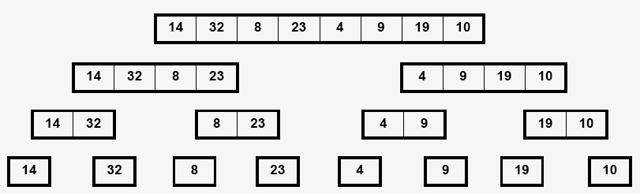
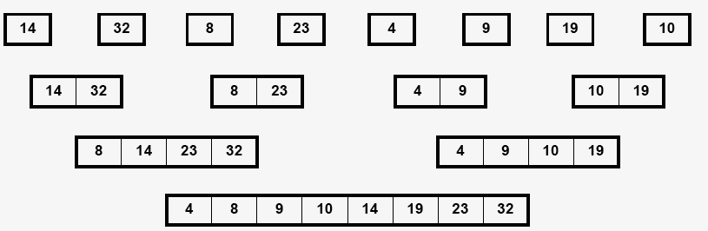
Merge Sort
Main idea:
Dividing is trivial
Merging is non-trivial
Input
(divide)
O(lg n) steps
How much work at every step?
O(n) sub-problems
(conquer)
O(lg n) steps
How much work at every step?

Slide 44
Merge sort Example
8
2
9
4
5
3
1
6
Divide
8 2 9 4
5 3 1 6
Divide
8 2
9 4
5 3
1 6
Divide
1 element
8 2 9 4 5 3 1 6
Merge
2 8 4 9 3 5 1 6
Merge
2 4 8 9 1 3 5 6
Merge
1 2 3 4 5 6 8 9

Slide 45
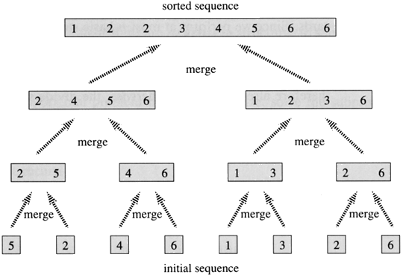
MERGE SORT

Slide 46
MERGE SORT

Slide 47
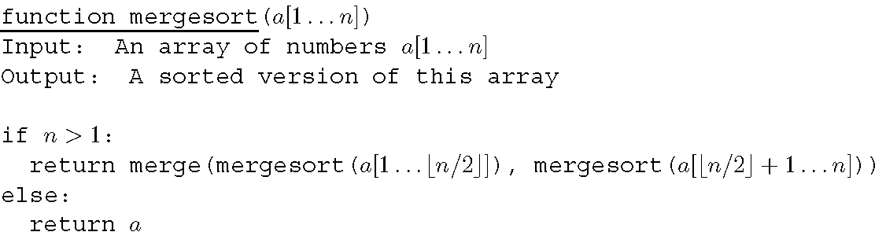
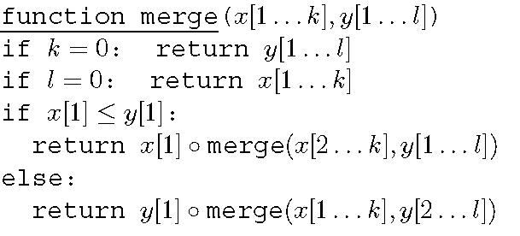
Merge
Sort
Algorithm
14

Slide 48
MERGE SORT
public static int[] MergeSort(int[] array) {
if (array.length < 2) return array;
int mid = array.length / 2;
int[] left = Arrays.copyOfRange(array, 0, mid);
int[] right = Arrays.copyOfRange(array, mid, array.length);
return merge(MergeSort(left), MergeSort(right));
}

Slide 49
MERGE SORT
public static int[] merge(int[] left, int[] right) {
int[] result = new int[left.length + right.length];
int i = 0,j = 0,k = 0;
while (i < left.length && j < right.length) {
if (left[i] <= right[j]) {
result[k++] = left[i++];
} else {
result[k++] = right[j++]; }
}
while (i < left.length) { result[k++] = left[i++]; }
while (j < right.length) {result[k++] = right[j++]; }
return result;
}

Slide 50
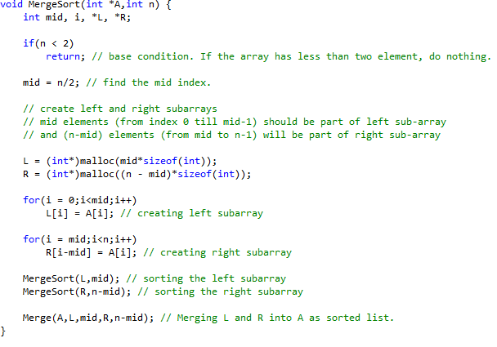
MERGE SORT

Slide 51
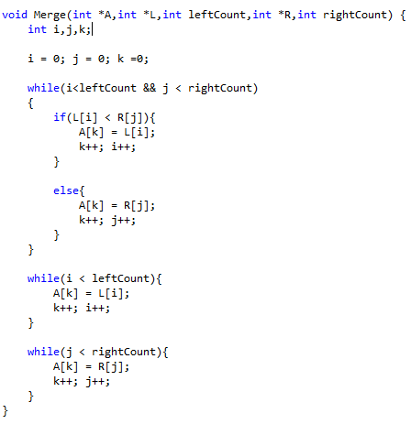
MERGE SORT
Notes:
Following writing merge_sort function, then it is required to merge both the left and right lists created above. There are several variants for the merge() function; one possibility is this:

Slide 52
Summary of Sorting Algorithms
Algorithm | Time | Notes
selection-sort | O(n²) | slow in-place for small data sets (< 1K)
insertion-sort | O(n²) | slow in-place for small data sets (< 1K)
merge-sort | O(n log n) | fast sequential data access for huge data sets (> 1M)

Slide 53
Sources used
Lectures by Mr. Mohammad Asad Abbasi

